Slide 1








E-COMMERCE ANALYSIS
By Omar Nasr

Slide 2
Project Overview
In This Project, We Analyze Amazon E-commerce Sales Data In India To Uncover Insights About Customer Behavior, Sales Performance, Focusing On Our Categories Purchasing And Most States And Cities That Make Most Orders.
The Focus Is On Understanding Sales Trends, Fulfillment Channels, And Ship Service Level To Help Businesses Optimize Their Strategies And Improve Profitability.
In This Project Also Focusing On The Price Of Our Categories In Different MRP Like Amazon, Snapdeal, Myntra And So On.

Slide 3
Project Goals
Identify Total Sales And Number Of Orders Overtime.
Analyze The Performance Of Different Sales Channels (Amazon,Non-amazon).
Analyze Our Categories Purchasing Behavior In General.
Highlight Operational Insights, Including Fulfillment Methods And Their Impact On Sales.
Focusing On The Best Selling Size And Color In General.
Follow The Number Of Stocks For Our Categories.
Extract Benefit Insights To Improve Total Sales And Number Of Orders.

Slide 4

Methodology
Data Used:
•Sales Transactions: Details On Category Sold, Total Amount, And Quantities.
•Fulfillment Channels: Breakdown Of Sales Through Amazon, Non-amazon, Merchant Fulfillment.
•Customer Segmentation: Data On Demographics, Geography, And Order History.
•Time Period: Data Spans Across[from 31-3-2022 To 29-6-2022].
•Details About Number Of Stocks, Color And Size.
•Comparing Prices Of Different Categories Across Different MRP.
•

Slide 5
Methodology
Tools Used:
SQL:
For Exploring Data In General, Write A Lot Useful Queries To Understanding Data Very Well, Making Relation Between Different Data To Help In Extract Insights , Asking Question And Make Joins For Exploring And Finally Making A Lot Data Cleaning For Null Values, Duplicates And So On.
Tableau Public:
For Interactive Dashboards And Visualizations.

Slide 6
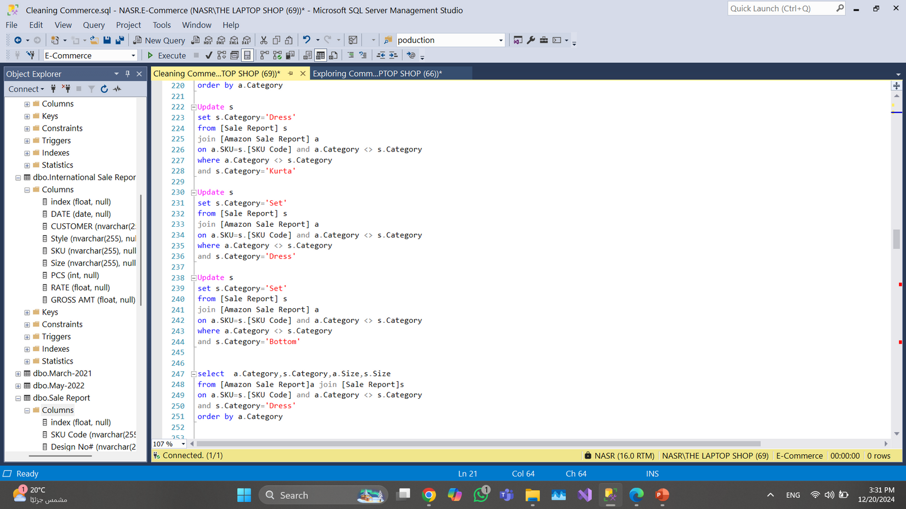
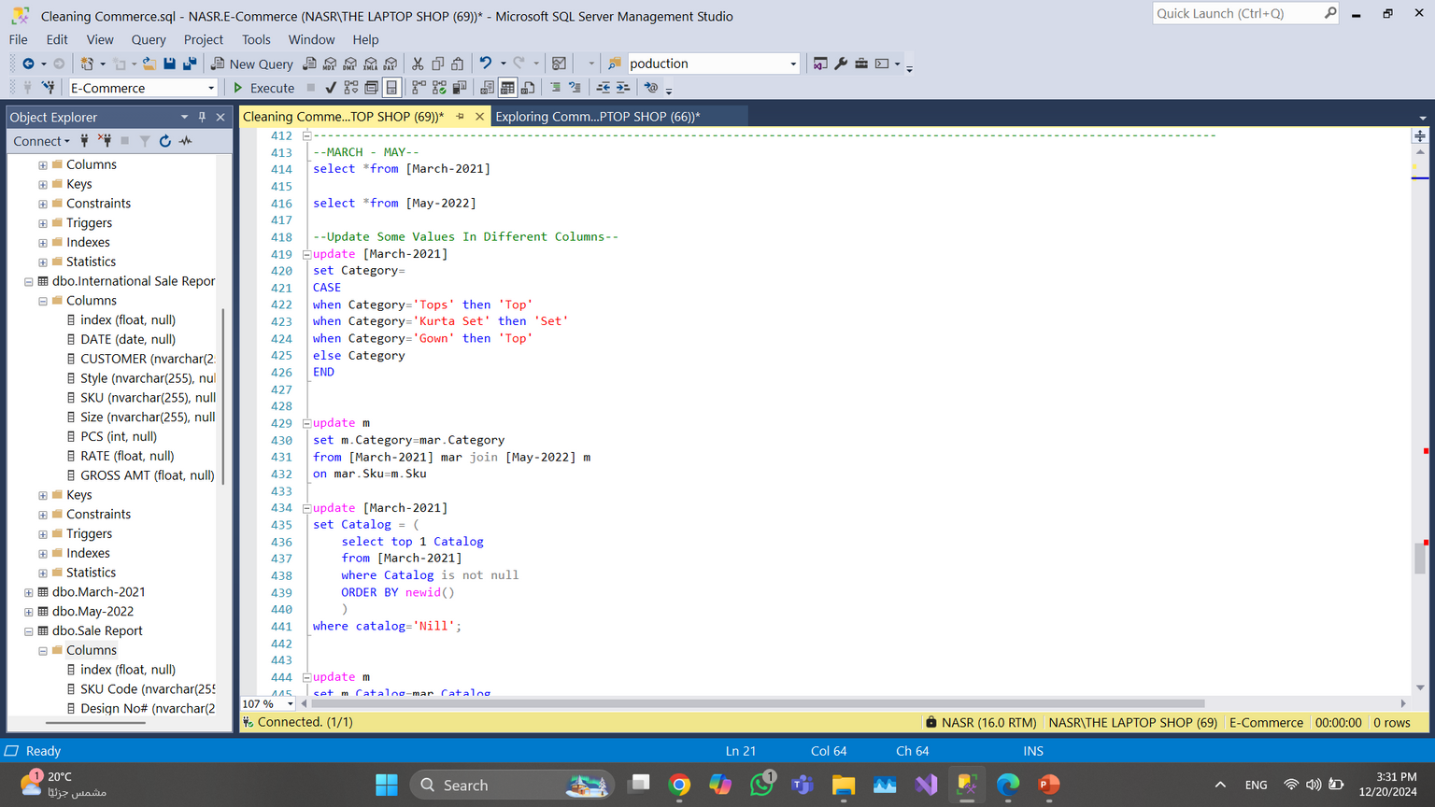
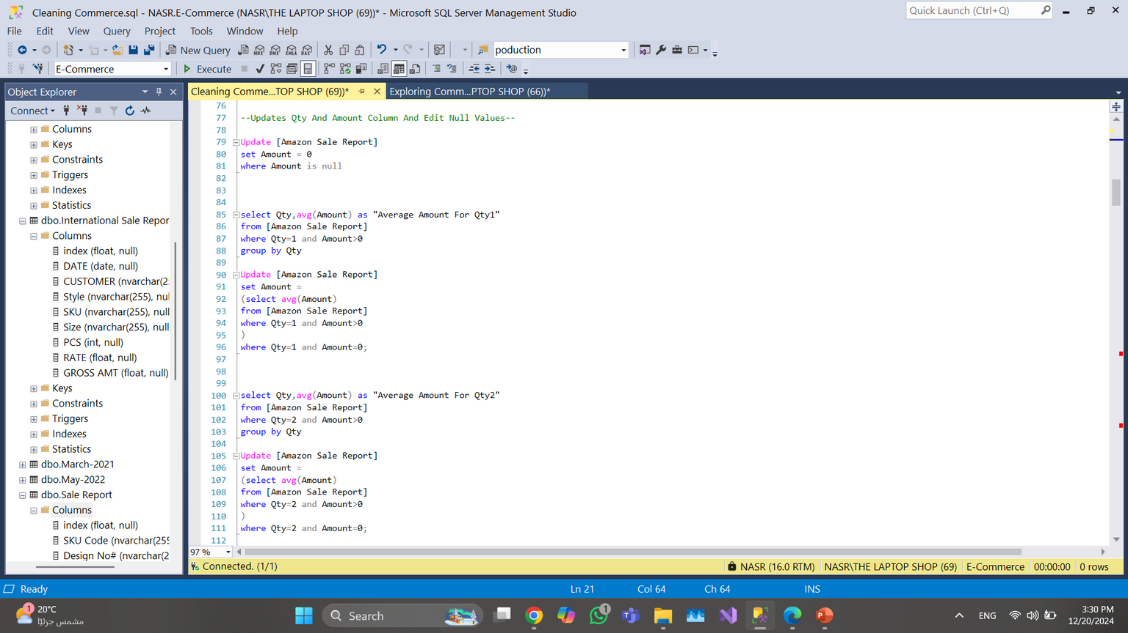
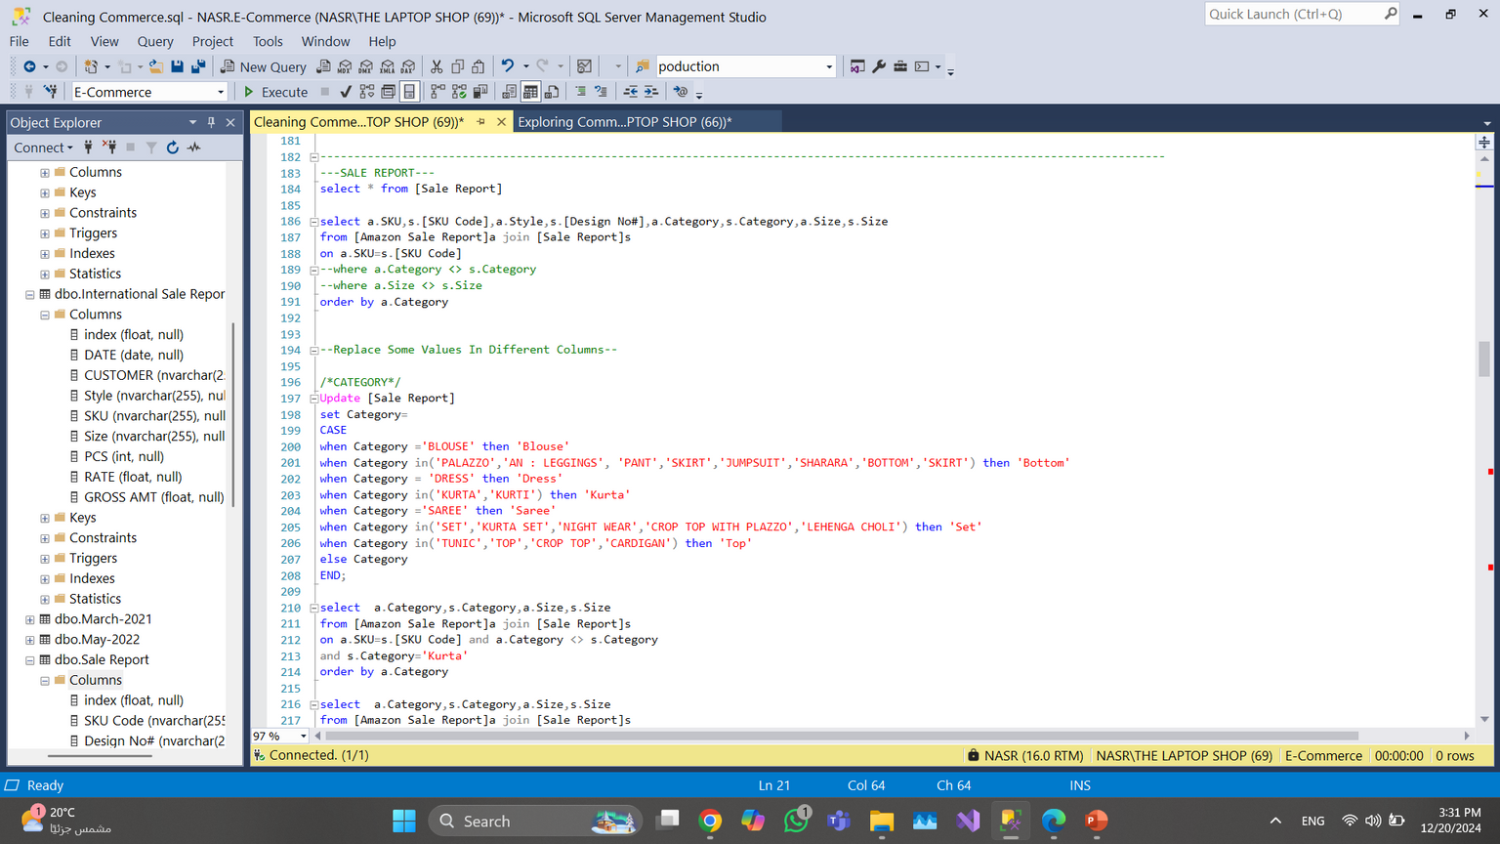
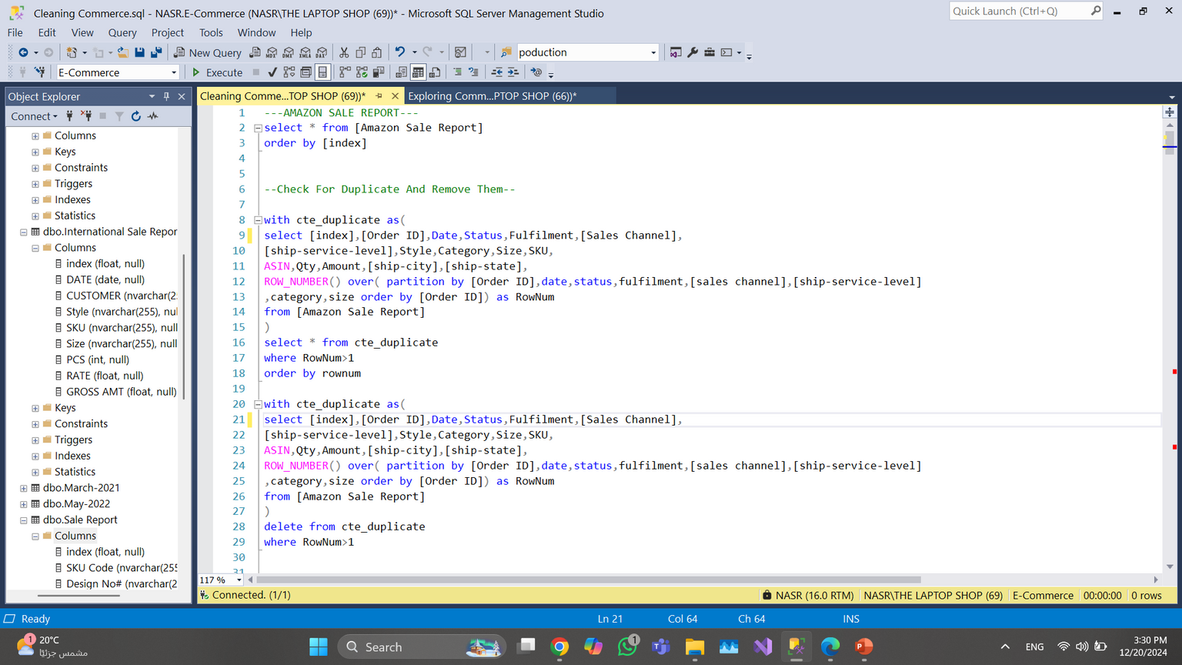
Cleaning Data
Remove Duplicates And Processing Null Values.
Unification Name Of Categories, Size , Status And Other Values In All Data Files.
Updates Missing Values In All Columns.
Modify Incomprehensible Values And Unifying Them In General.
Delete Unused Column.

Slide 7
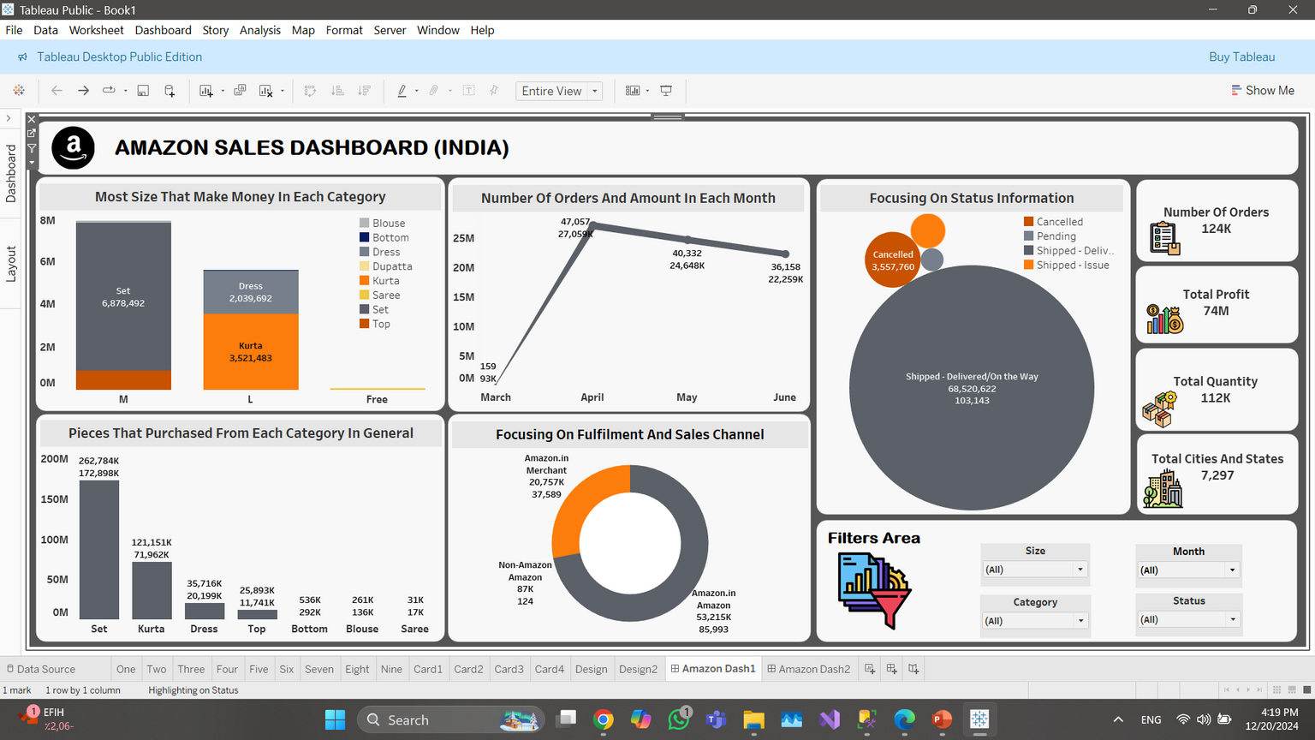
exploring and insights
From First Dashboard We Can Extract Valuable Insights Like:
Most Number Of Orders And Total Sales In April And The Values Are Considered Similar In The Remaining Months Except March.
Most Category That Make Money And Most Number Of Pieces Are Purchased Is Set And All Other Categories Their Values Very Far.
When Focusing In The Size We Found That Most Size That Purchased Is Medium Especially In Set.
Most Of Our Orders Were Under The Supervision Of Amazon In General But We Noticed That The Price Is High In That Case.
Most Orders Are Shipped And A Small Percentage Is Considered Canceled Or Waiting

Slide 8
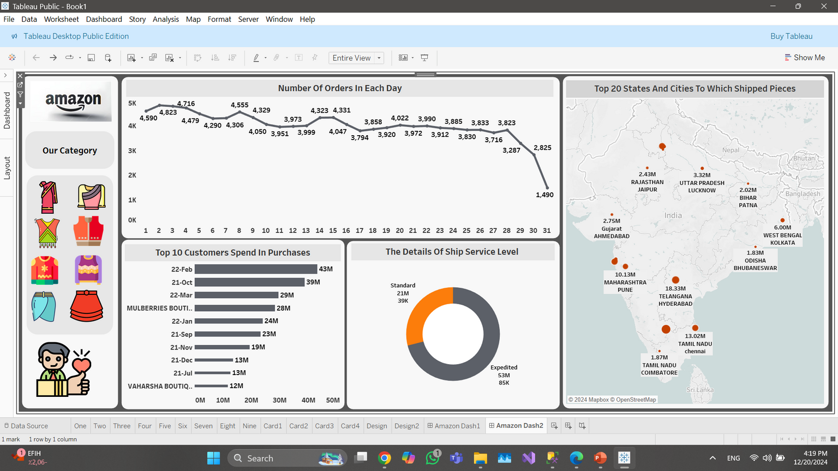
exploring and insights
From Second Dashboard We Found:
First Days In Month Number Of Orders Are Most And Other Days The Values Are Similar And The Last Days We Noticed Decreasing In Orders.
Most Of Our Customers Spend A Lot Of Money In Purchasing Process And The Most Is 22-Feb Customer.
Most Of Orders Are Hurry So The Customers Used Expedited Ship Server Although It Requires More Money.
Most Of Our Orders Were Shipped To All Places In India But We Noticed That TELANGANA And TAMIL NADU Are The Most

Slide 9
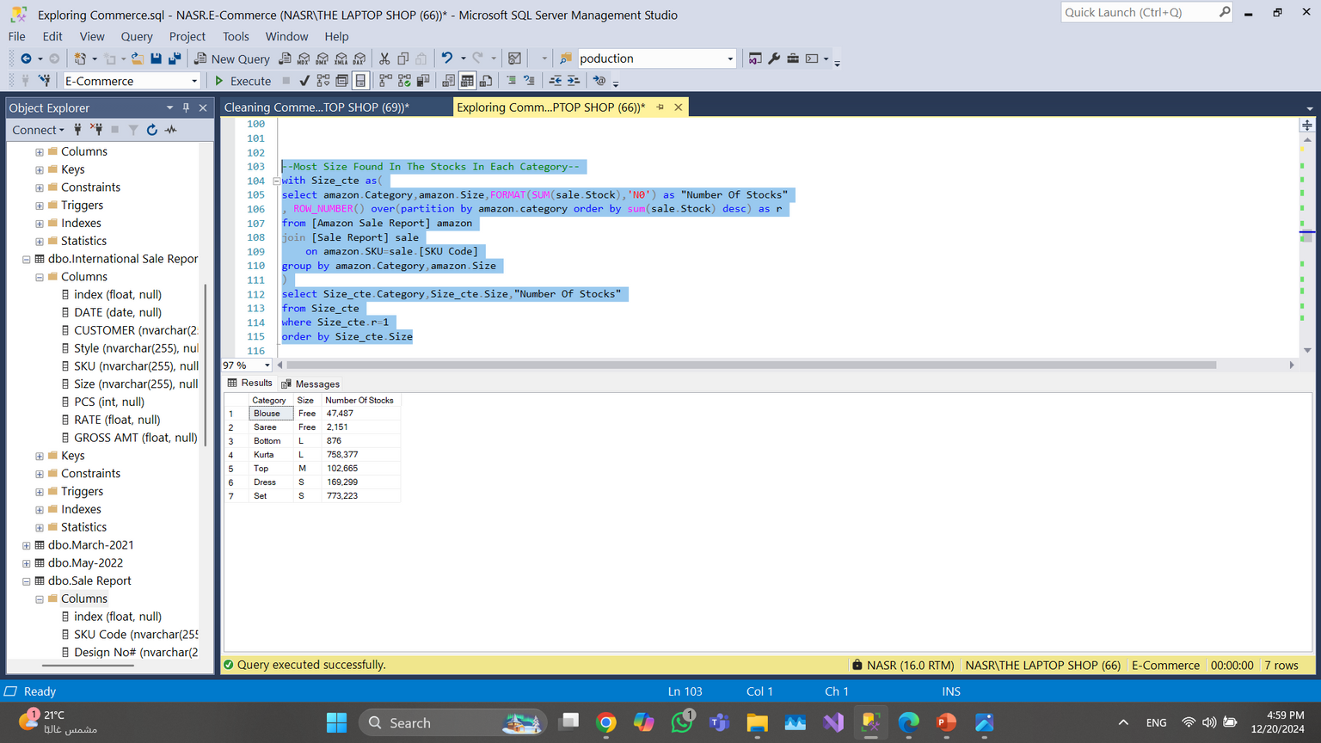
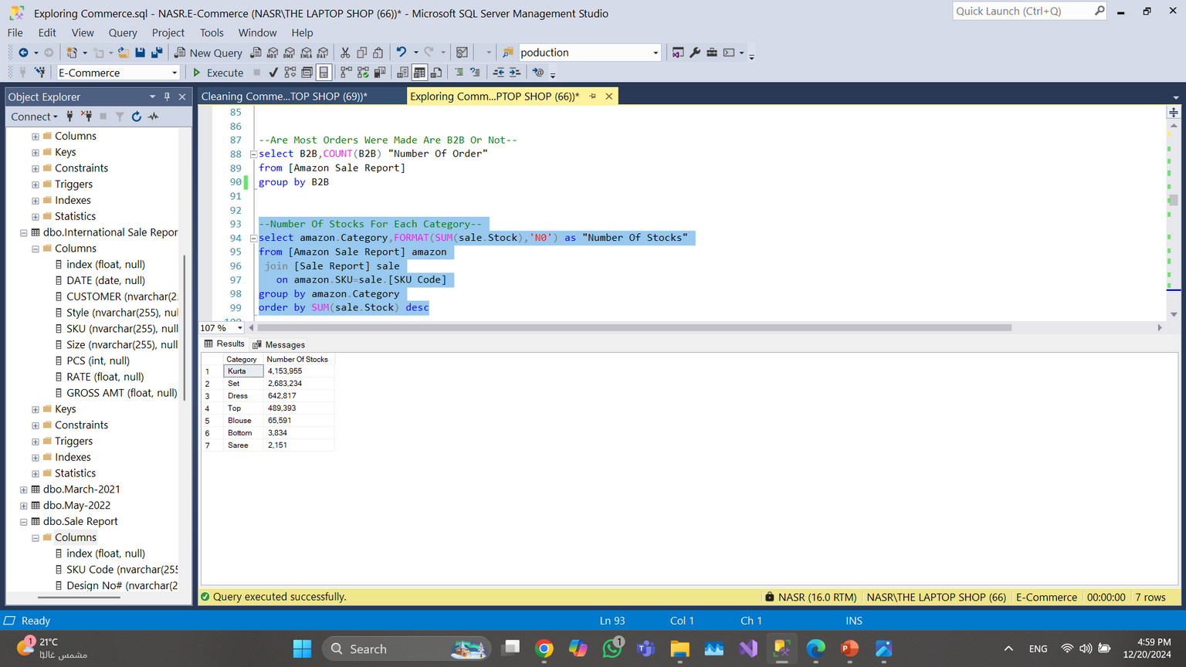
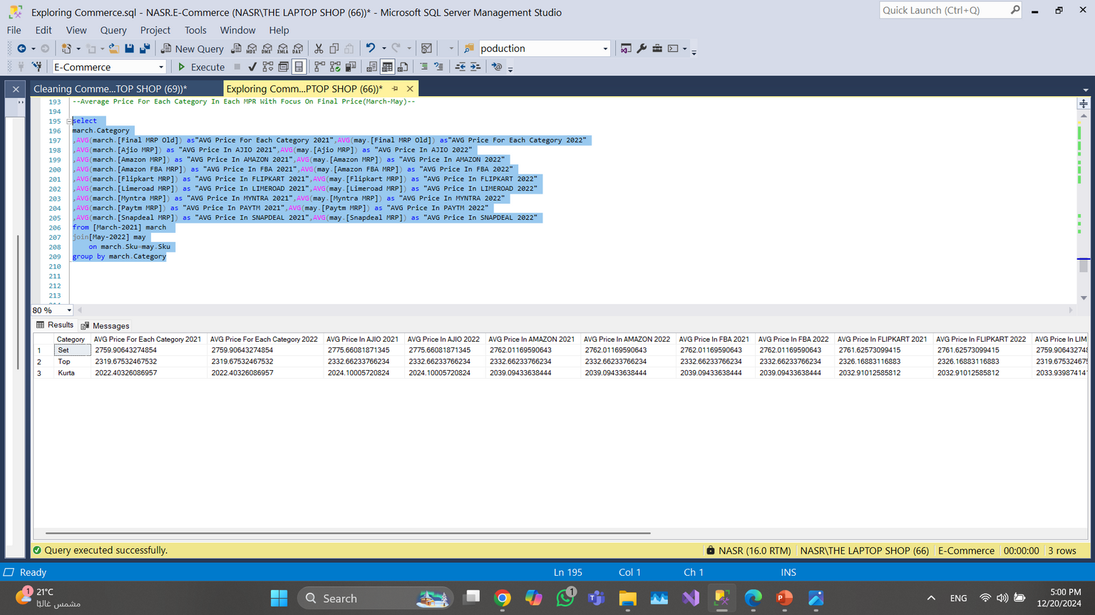
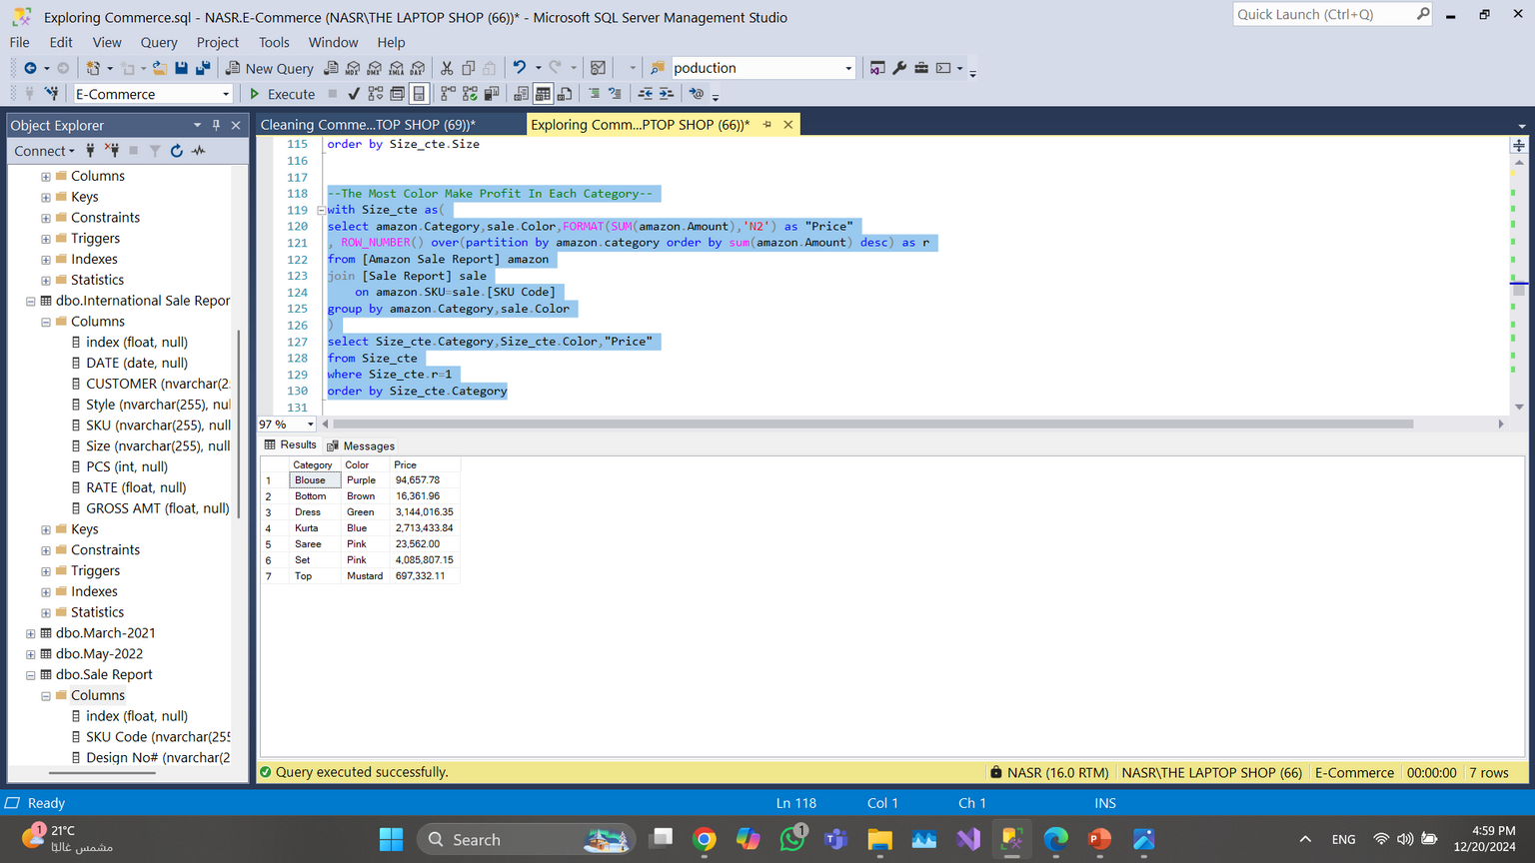
exploring and insights
All Categories And Catalog In Different MRP Their Prices Are The Same Without Any Different Whether In March 2021 Or May 2022.
Most Category Was Found In Stocks Is Kurta And Set And This Consider Good Cause These Are Most Categories Are Purchased.
Most Sizes Also Found In Stocks Were For Kurta And Set And They Small And Large.
In General Most Orders Not Big Sizes And The Number Of Them In Stocks Also Are Few.
Most Light Colors Make A lot Money Unlike Other Colors.

Slide 10
recommendation
Launching Marketing Campaigns Or Special Promotions During April Period To Maximize Sales More And More.
Make Special Offer In March To Increase Sales In This Period.
As The "Set" Category Generates The Most Revenue And Has The Highest Number Of Purchases Increase The Variety And Stock Levels Of Products In This Category.
Focus On Designing More Product In The Small Size With Make Offers In Big Sizes In Same Time To Make Purchasing Process Varied Between All Sizes.
Minimize Cancellations And Waiting Orders By Analyze Reasons For Cancellations And Address Recurring Issues (E.G., Payment Problems, Delays).
Make Marketing Campaigns In Region That Purchased A Little To Increasing Number Of Purchasing Process In It.
recommendation

Slide 11
recommendation
Making Offers From Time To Time For Our Customers In Order To Increase Their Demand For Buying Products.
Developing Expedited Shipping More To Make More Customer Used It As It Is More Expensive Than Standard As This Increase Profit In General.
Making A Lot Of Offers On The First Day Of The Month , While Preventing Workers Leaves In That Period Because Of The Large Number Of Orders Unlike The Last Days Of The Month.
Focus On Increasing Stock Levels For The Most In-demand Categories, Such As "Kurta And Set", As They Have Proven To Be The Most Popular And Reduce Inventory For Less Popular Categories To Avoid Unnecessary Storage Costs.
Enhance Marketing Efforts For Light-colored Products, As They Generate The Highest Profits Compared To Other Colors.
Review Pricing Strategies Regularly Evaluate Product Pricing To Ensure Alignment With Demand, Especially Since Prices Remained Unchanged Between March 2021 And May 2022.
recommendation

Slide 12
THANK
YOU
Omar Nasr

